Slide 1


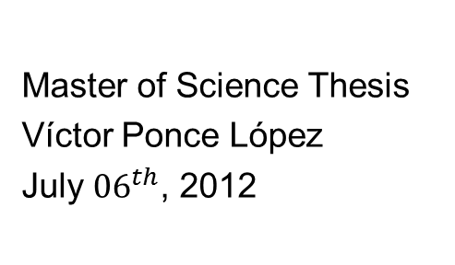
Multi-Modal Human Gesture Recognition combining Dynamic Programming and Probabilistic methods
Master of Science Thesis
Víctor Ponce López
July ${06}^{th}$, 2012
Advisors:
Sergio Escalera Guerrero
Xavier Baró Solé

Slide 2
Outline
Introduction
Multi-Modal feature spaces
Probabilistic modelling of gestures
Sub-Gesture Representation
Experiments and Results
Applications
Conclusion and Future Work

Slide 3
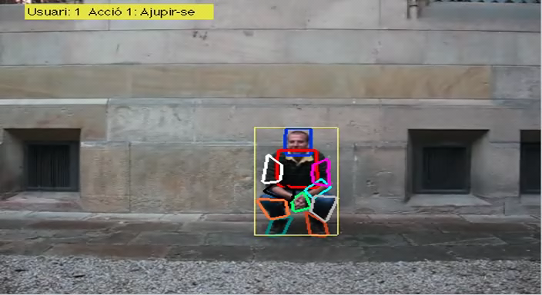
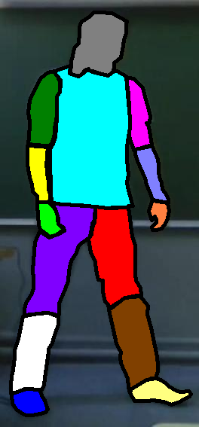
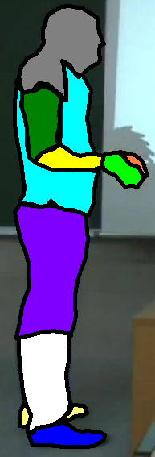
Motivation
Introduction | M-M Feature Spaces | Probabilistic Modelling of Gestures | Sub-Gesture Representation | Experiments | Applications | Conclusions and Future
Challenging tasks:
Human Pose (HP) recovery and description in image sequences.
Composition of HPs for Human Gesture Recognition (HGR).
Applicability in health and social contexts.

Slide 4
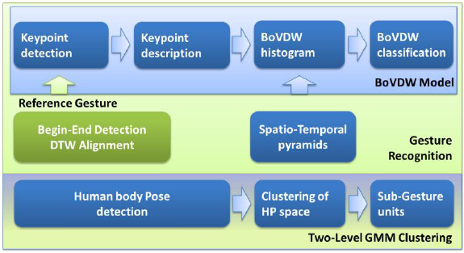
Thesis Goals
Introduction | M-M Feature Spaces | Probabilistic Modelling of Gestures | Sub-Gesture Representation | Experiments | Applications | Conclusions and Future
Deal with the problem of Human Gesture Recognition (HGR) using HBA.
Discriminative representation of HPs.
Improved HGR.
Computing Multi-Modal Feature Spaces
Probabilistic Modelling of Gestures
Sub-Gesture Representation

Slide 5
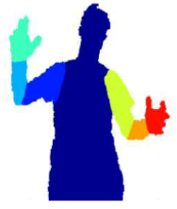
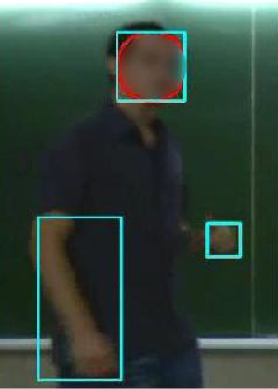
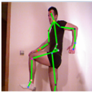
Description of HPs
Introduction | M-M Feature Spaces | Probabilistic Modelling of Gestures | Sub-Gesture Representation | Experiments | Applications | Conclusions and Future
Describe the feature space of HPs.
Extract the interesting elements or patterns of the image.
Combine them for describing the features.
Bag-of-Words (BoW) used in document analysis.
In images, Words become visual elements of a certain vocabulary.
Bag-of-Visual-Words (BoVW) one of the most used approaches in Computer Vision.
Spatio-Temporal-Visual-Words (STVW) recently proposed as an extension of BoW from still images to image sequences.

Slide 6
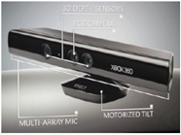
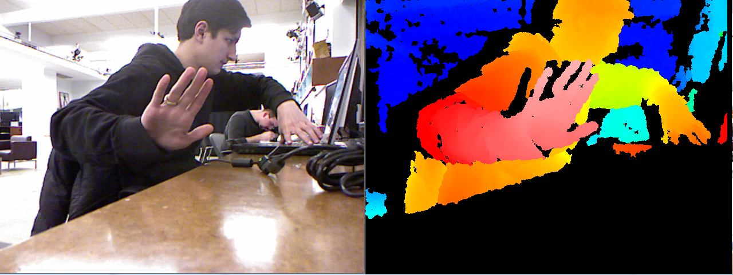
Description of HPs
Introduction | M-M Feature Spaces | Probabilistic Modelling of Gestures | Sub-Gesture Representation | Experiments | Applications | Conclusions and Future
Depth included as a new source of information.
Exploited for human body segmentation and tracking
Extract HPs and the development of 3-D descriptors.

Slide 7
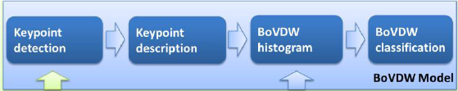
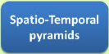
BoVDW approach (1)
Introduction | M-M Feature Spaces | Probabilistic Modelling of Gestures | Sub-Gesture Representation | Experiments | Applications | Conclusions and Future
Multi-modal RGB-D data is acquired and stored from different sensors of people performing a large amount of gestures.
Compute the feature space extracting different state-of-the-art multi-modal features.
Combine the features in a fusion strategy and codify the computed space in a Bag-of-Visual-and-Depth-Words (BoVDW).
Compare the HGR Performance obtained with our BoVDW descriptor to other common used descriptors.

Slide 8
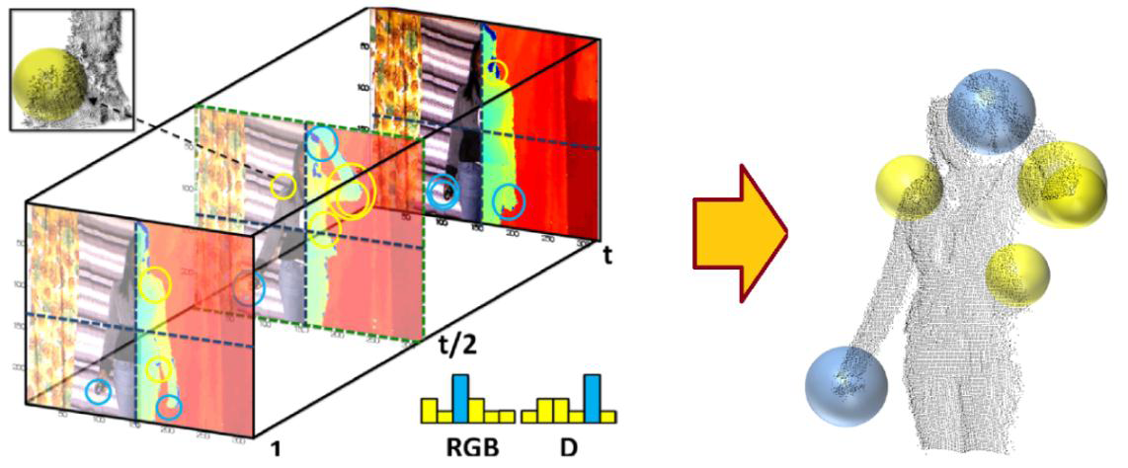
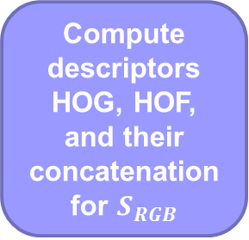
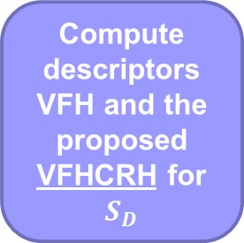
BoVDW approach (2)
Introduction | M-M Feature Spaces | Probabilistic Modelling of Gestures | Sub-Gesture Representation | Experiments | Applications | Conclusions and Future
Keypoint detection
STIP detector applied to RGB and Depth volumes separately
Obtain two sets of interest points
Keypoint description
Compute descriptors HOG, HOF, and their concatenation for $S_{RGB}$
Compute descriptors VFH and the proposed VFHCRH for $S_{D}$

Slide 9
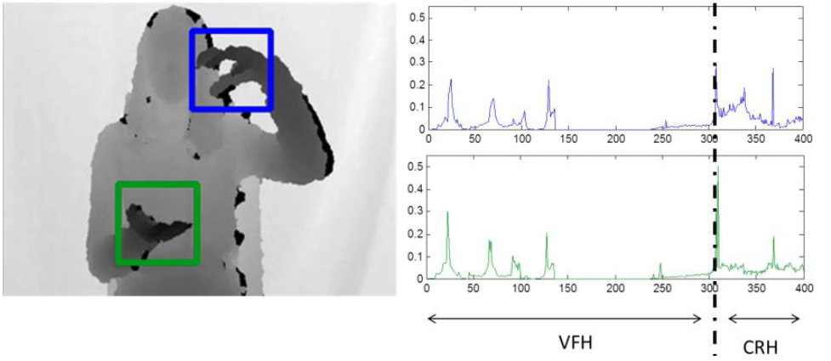
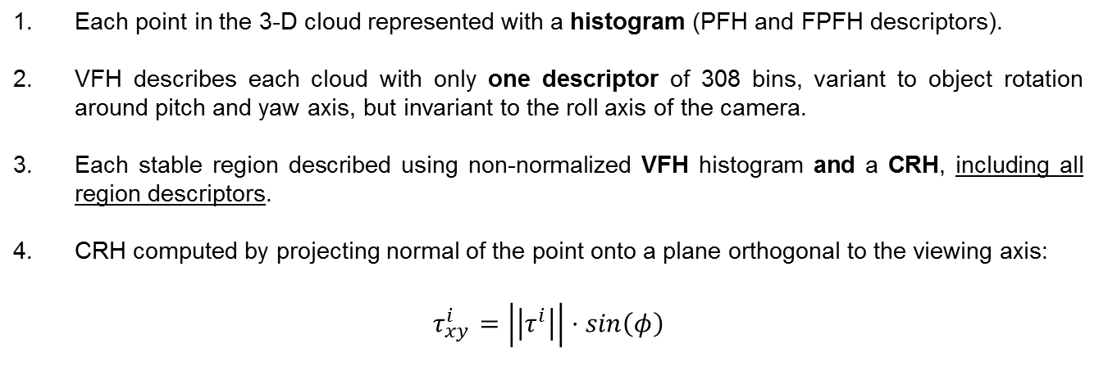
BoVDW approach (3)
Introduction | M-M Feature Spaces | Probabilistic Modelling of Gestures | Sub-Gesture Representation | Experiments | Applications | Conclusions and Future
Each point in the 3-D cloud represented with a histogram (PFH and FPFH descriptors).
VFH describes each cloud with only one descriptor of 308 bins, variant to object rotation around pitch and yaw axis, but invariant to the roll axis of the camera.
Each stable region described using non-normalized VFH histogram and a CRH, including all region descriptors.
CRH computed by projecting normal of the point onto a plane orthogonal to the viewing axis:
$$τ_{xy}^{i}=\left|\left|τ^{i}\right|\right|⋅sin\left(φ\right)$$

Slide 10
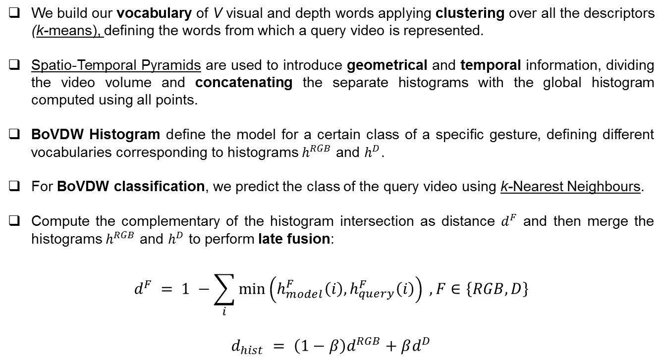
BoVDW approach (4)
Introduction | M-M Feature Spaces | Probabilistic Modelling of Gestures | Sub-Gesture Representation | Experiments | Applications | Conclusions and Future
We build our vocabulary of V visual and depth words applying clustering over all the descriptors (k-means), defining the words from which a query video is represented.
Spatio-Temporal Pyramids are used to introduce geometrical and temporal information, dividing the video volume and concatenating the separate histograms with the global histogram computed using all points.
BoVDW Histogram define the model for a certain class of a specific gesture, defining different vocabularies corresponding to histograms $h^{RGB}$ and $h^{D}$.
For BoVDW classification, we predict the class of the query video using k-Nearest Neighbours.
Compute the complementary of the histogram intersection as distance $d^{F}$ and then merge the histograms $h^{RGB}$ and $h^{D}$ to perform late fusion:
$$d^{F} = 1 −\sum_{i}{\min\left(h_{model}^{F}\left(i\right),h_{query}^{F}\left(i\right)\right)} , F∈\left\{RGB,D\right\}$$
$$d_{hist} = \left(1−β\right)d^{RGB}+βd^{D}$$

Slide 11
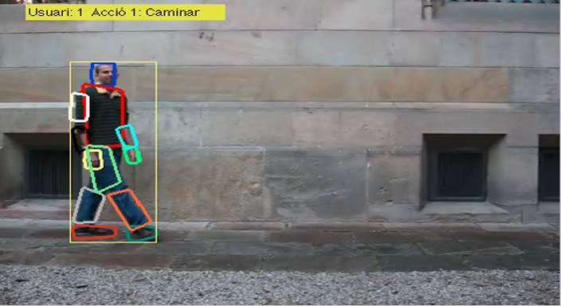
Dynamic Programming and Probabilistic methods
Introduction | M-M Feature Spaces | Probabilistic Modelling of Gestures | Sub-Gesture Representation | Experiments | Applications | Conclusions and
Human Gestures are described as continuous sequences of data points (temporal series) → relevant information for posterior HBA.
Probabilistic Graphical Models such as Hidden Markov Models (HMM) or Conditional Random Fields (CRF).
Dynamic Time Warping (DTW) offers a temporal alignment between sequences of different lengths.
We propose to model this variance caused by environmental factors using a probabilistic based approach.

Slide 12
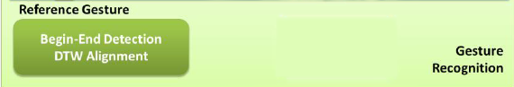
Probabilistic-Based DTW approach (1)
Introduction | M-M Feature Spaces | Probabilistic Modelling of Gestures | Sub-Gesture Representation | Experiments | Applications | Conclusions and
Integrate the presented BoVDW approach in a fully-automatic system for HGR.
Uses a novel Probabilistic-Based DTW for the segmentation of gestures in a sequence.
Compare with both original DTW and HMM using the proposed measures for distance and probability.

Slide 13
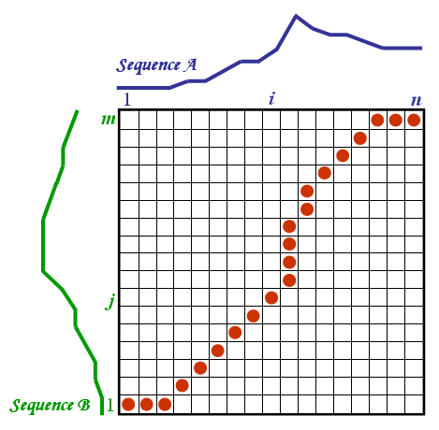
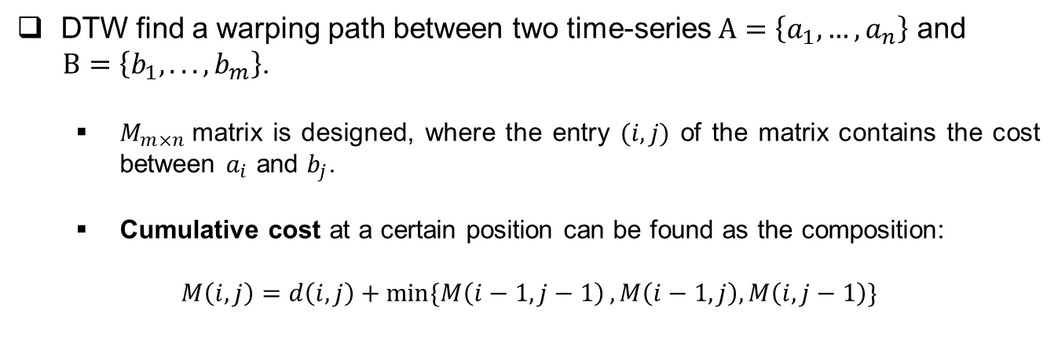
Probabilistic-Based DTW approach (2)
Introduction | M-M Feature Spaces | Probabilistic Modelling of Gestures | Sub-Gesture Representation | Experiments | Applications | Conclusions and
DTW find a warping path between two time-series $A=\left\{a_{1},…,a_{n}\right\}$ and
$B=\left\{b_{1},...,b_{m}\right\}$.
$M_{m×n}$matrix is designed, where the entry $(i,j)$ of the matrix contains the cost between $a_{i}$ and $b_{j}$.
Cumulative cost at a certain position can be found as the composition:
$$M\left(i,j\right)=d\left(i,j\right)+\min{\{M\left(i−1,j−1\right)},M\left(i−1,j\right),M\left(i,j−1\right)\}$$

Slide 14
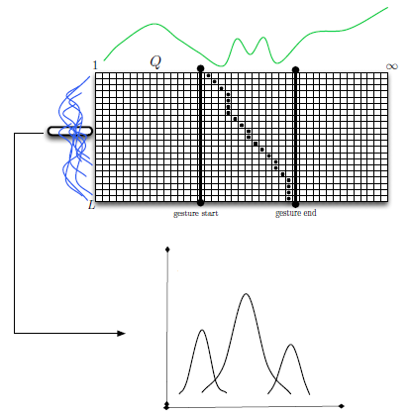
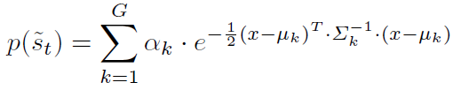
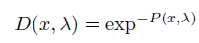
Probabilistic-Based DTW approach (3)
Introduction | M-M Feature Spaces | Probabilistic Modelling of Gestures | Sub-Gesture Representation | Experiments | Applications | Conclusions and
Align with DTW the sequences respect to the mean length sequence
Consider a training set of N sequences
Compute the probability of x belonging to the whole GMM, and a soft-distance based measure of the probability
Create L (mean length) GMMs for each element of the sequences
Therefore, we obtain a methodology for gesture detection able to deal with multiple temporal deformations of the gesture categories.

Slide 15
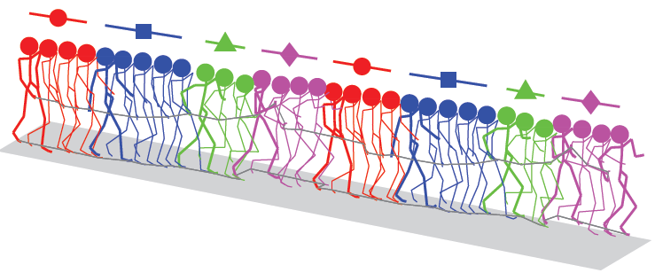
Sub-Gesture Representation
Introduction | M-M Feature Spaces | Probabilistic Modelling of Gestures | Sub-Gesture Representation | Experiments | Applications | Conclusions and
Discretization of gestures in smaller units using composition of both HPs and these units.
[1]
Sequences of Sub-Gesture units can be modelled using a temporal model (HMM).
Final inference consists of testing the methodology on a large scale data set of gestures.
Decomposition improves HGR, and hence we can obtain better HBA systems.
[1] Feng Zhou, Fernando De la Torre, Jessica K. Hodgins, "Hierarchical Aligned Cluster Analysis for Temporal Clustering of HumanMotion," IEEE Transactions on Pattern Analysis and Machine Intelligence, 14 Jun. 2012.

Slide 16
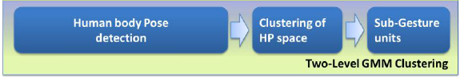
Sub-Gesture approach (1)
Introduction | M-M Feature Spaces | Probabilistic Modelling of Gestures | Sub-Gesture Representation | Experiments | Applications | Conclusions and
Construct a new feature space of HPs through the structural model of human body joints from depth for better visual interpretation.
Propose a linear combination of means using two-level GMM process to perform clustering of the HPs space.
Allows obtaining more intuitive modelling of features and the first Sub-Gesture units.
These Sub-Gesture Units are coherent HP sets which can be useful to train posterior general purpose HBA systems.

Slide 17
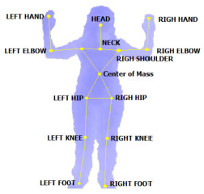
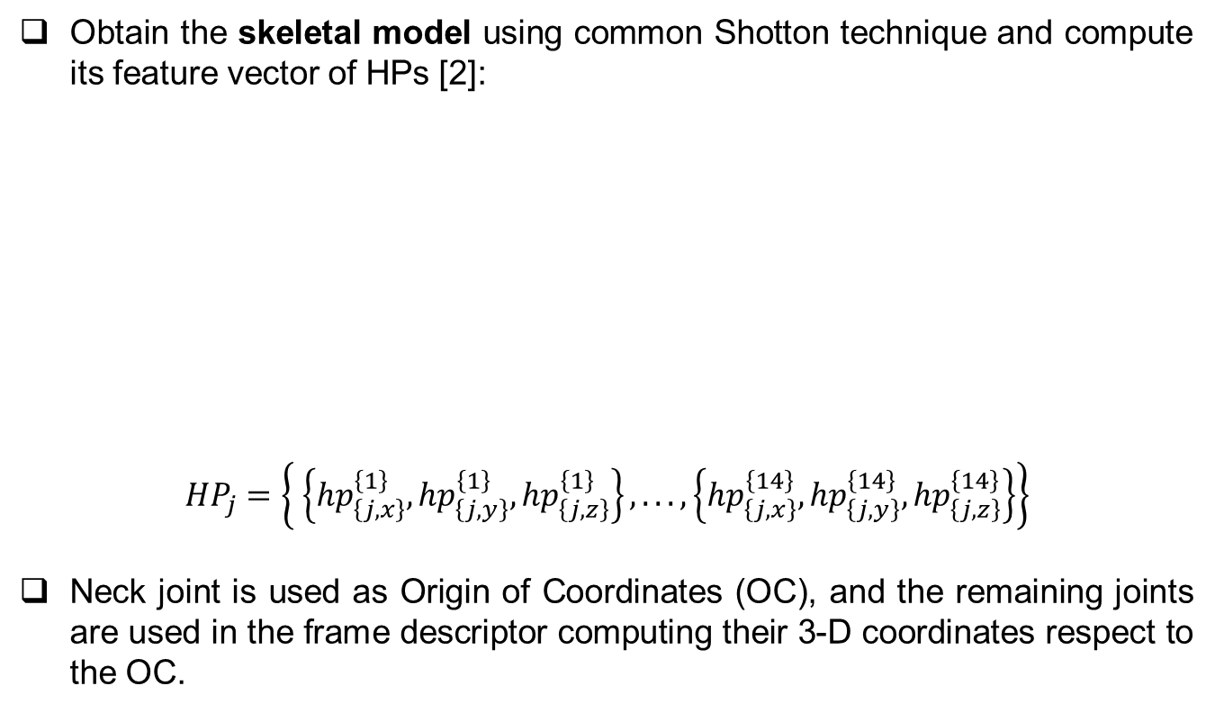
Sub-Gesture approach (1)
Introduction | M-M Feature Spaces | Probabilistic Modelling of Gestures | Sub-Gesture Representation | Experiments | Applications | Conclusions and
Obtain the skeletal model using common Shotton technique and compute its feature vector of HPs [2]:
$${HP}_{j}=\left\{ \left\{{hp}_{\left\{j,x\right\}}^{\left\{1\right\}},{hp}_{\left\{j,y\right\}}^{\left\{1\right\}},{hp}_{\left\{j,z\right\}}^{\left\{1\right\}}\right\}, ...,\left\{{hp}_{\left\{j,x\right\}}^{\left\{14\right\}},{hp}_{\left\{j,y\right\}}^{\left\{14\right\}},{hp}_{\left\{j,z\right\}}^{\left\{14\right\}}\right\}\right\}$$
Neck joint is used as Origin of Coordinates (OC), and the remaining joints are used in the frame descriptor computing their 3-D coordinates respect to the OC.
[2] J. Shotton, A. Fitzgibbon, M. Cook, T. Sharp, M. Finocchio, R. Moore, A. Kipman, and A. Blake. Real-time human pose recognition in parts from single depth images. CVPR, 2011.

Slide 18
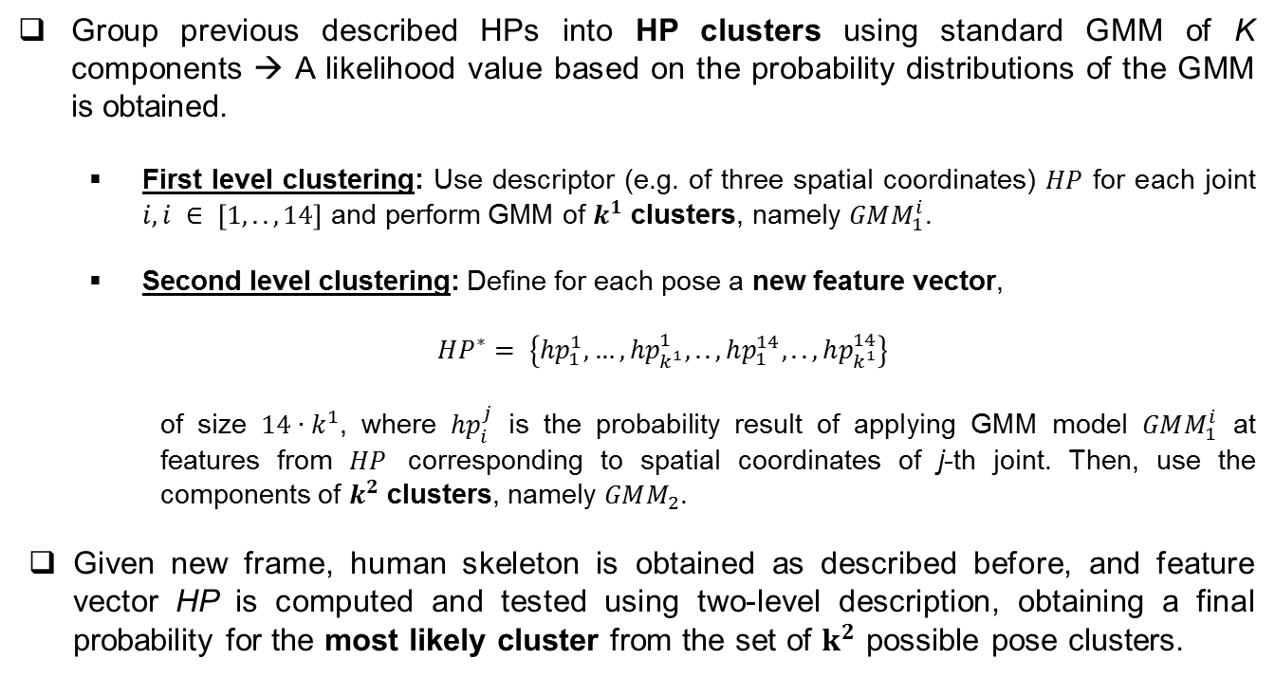
Sub-Gesture approach (2)
Introduction | M-M Feature Spaces | Probabilistic Modelling of Gestures | Sub-Gesture Representation | Experiments | Applications | Conclusions and
Group previous described HPs into HP clusters using standard GMM of K components → A likelihood value based on the probability distributions of the GMM is obtained.
First level clustering: Use descriptor (e.g. of three spatial coordinates) $HP$ for each joint $i, i ∈ \left[1,..,14\right]$ and perform GMM of $k^{1}$ clusters, namely $GMM_{1}^{i}$.
Second level clustering: Define for each pose a new feature vector,
$$HP^{∗}= \left\{hp_{1}^{1},…,hp_{k^{1}}^{1},..,hp_{1}^{14},..,hp_{k^{1}}^{14}\right\}$$
of size $14∙k^{1}$, where $hp_{i}^{j}$ is the probability result of applying GMM model $GMM_{1}^{i}$ at features from $HP$ corresponding to spatial coordinates of j-th joint. Then, use the components of $k^{2}$ clusters, namely $GMM_{2}$.
Given new frame, human skeleton is obtained as described before, and feature vector HP is computed and tested using two-level description, obtaining a final probability for the most likely cluster from the set of $k^{2}$ possible pose clusters.

Slide 19
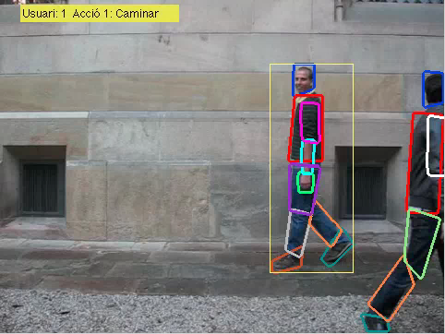
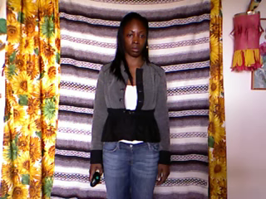
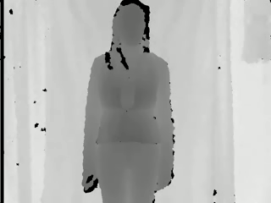
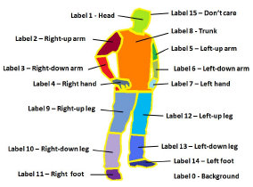
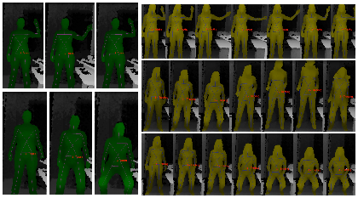
Data sets used and designed
Introduction | M-M Feature Spaces | Probabilistic Modelling of Gestures | Sub-Gesture Representation | Experiments | Applications | Conclusions and Future
ChaLearn
HuPBA
Gestures
HumanLimb

Slide 20
Experimental settings
Introduction | M-M Feature Spaces | Probabilistic Modelling of Gestures | Sub-Gesture Representation | Experiments | Applications | Conclusions and Future
Probabilistic-Based DTW
Applied to all sequences to detect a reference gesture.
We consider that a gesture is correctly detected if overlapping in the resting gesture sub-sequence is greater than 60%.
Cost-threshold was obtained by cross-validation on training data.
Each GMM was fitted with 4 components.
HMM was trained using Baum-Welch algorithm with 3 states experimentally set for the resting gesture, using a vocabulary of 60 symbols computed using K-Means over the training data features.
Final recognition is performed with temporal sliding windows of different wide sizes, based on the training samples length variability.

Slide 21
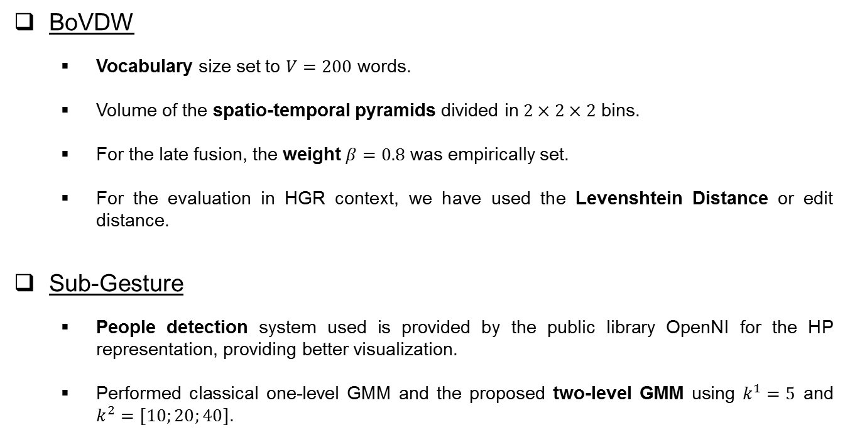
Experimental settings
Introduction | M-M Feature Spaces | Probabilistic Modelling of Gestures | Sub-Gesture Representation | Experiments | Applications | Conclusions and Future
BoVDW
Vocabulary size set to $V=200$ words.
Volume of the spatio-temporal pyramids divided in $2×2×2$ bins.
For the late fusion, the weight $β=0.8$ was empirically set.
For the evaluation in HGR context, we have used the Levenshtein Distance or edit distance.
Sub-Gesture
People detection system used is provided by the public library OpenNI for the HP representation, providing better visualization.
Performed classical one-level GMM and the proposed two-level GMM using $k^{1}=5$ and $k^{2}=[10;20;40]$.

Slide 22
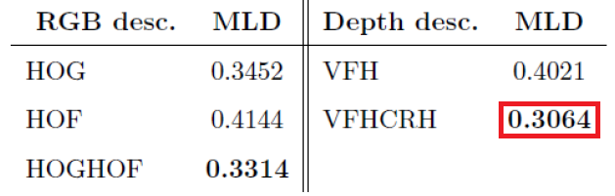
BoVDW results
Introduction | M-M Feature Spaces | Probabilistic Modelling of Gestures | Sub-Gesture Representation | Experiments | Applications | Conclusions and Future
Results using ChaLearn data set.
MLD
Batches

Slide 23
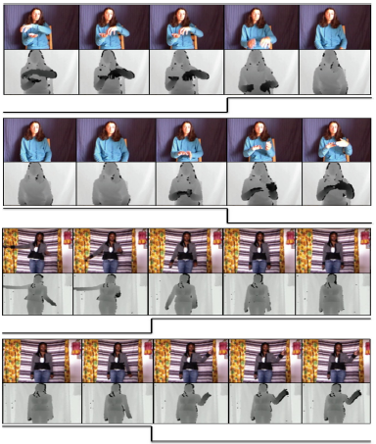
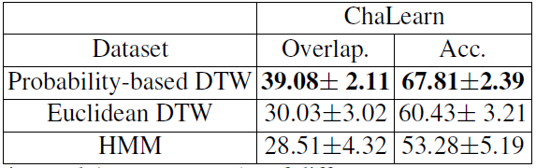
Probabilistic-Based DTW results
Introduction | M-M Feature Spaces | Probabilistic Modelling of Gestures | Sub-Gesture Representation | Experiments | Applications | Conclusions and Future
Results using ChaLearn data set.

Slide 24
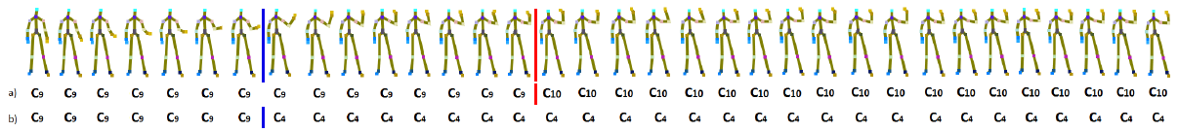
Sub-Gesture results
Introduction | M-M Feature Spaces | Probabilistic Modelling of Gestures | Sub-Gesture Representation | Experiments | Applications | Conclusions and Future
Results using Gesture data set.
All joints and spatial coordinates are considered independent in the one-level GMM, and large movement in a particular joint affects global clustering for a particular pose.
In two-level GMM clustering, first, all joints are independently clustered, and after grouped with equal probability in the second GMM level.

Slide 25

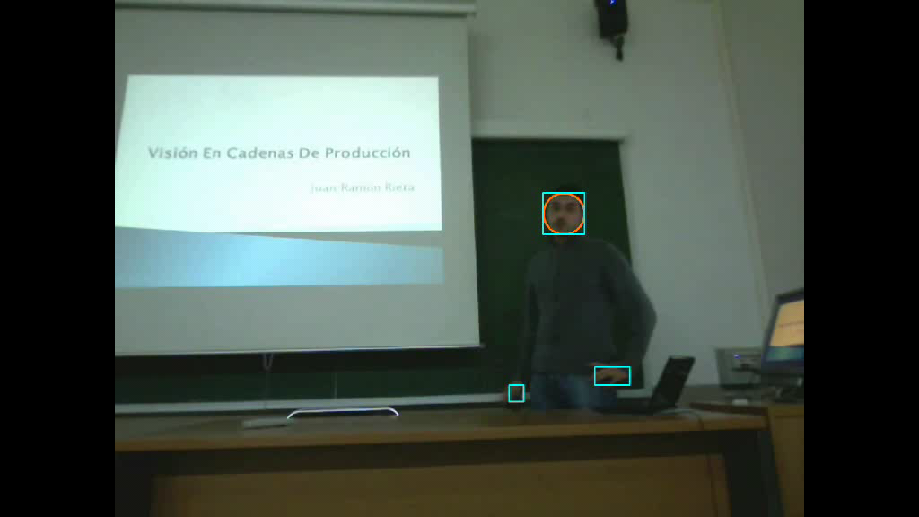
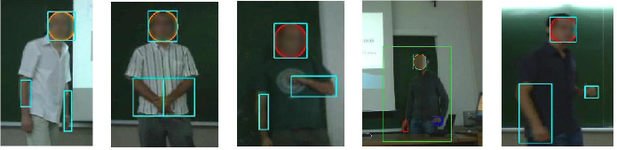
Applications
Introduction | M-M Feature Spaces | Probabilistic Modelling of Gestures | Sub-Gesture Representation | Experiments | Applications | Conclusions and Future
B.S. Thesis funded by Dept. Applied Mathematics and Analysis.
Consider non-verbal communication as specific case for HBA.
Overlapping between the annotations provided by the feedback from the evaluation committee of the student’s competences, and the impressions provided by our system using Adaboost classification.
Results of evaluation showed that the system discriminates the best grades from the worst above 90% of accuracy.

Slide 26

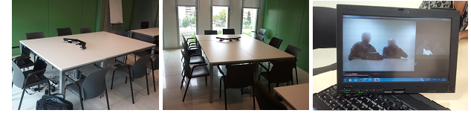
Applications
Introduction | M-M Feature Spaces | Probabilistic Modelling of Gestures | Sub-Gesture Representation | Experiments | Applications | Conclusions and Future
Project funded by the Department of Justice of the Generalitat.
Analysis of the communication process in criminal mediation situations:
Acquisition of multi-modal data.
Extracting behavior patterns of these situations applying HGR techniques.
Provide expert’s feedback from the situations for detecting why and when people opinions begin to match.

Slide 27

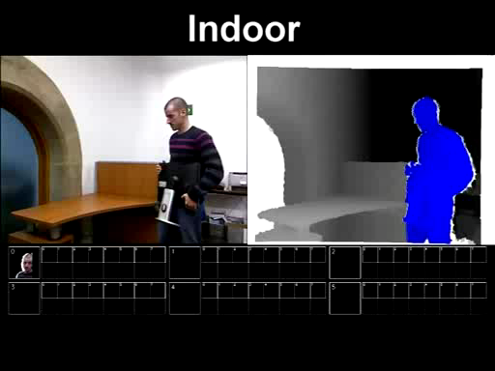
Applications
Introduction | M-M Feature Spaces | Probabilistic Modelling of Gestures | Sub-Gesture Representation | Experiments | Applications | Conclusions and Future
Project funded by the “Obra Social La Caixa”.
Monitoring and control the actions of ancients having several kind of dementias (like Alzheimer) or physical incapacities.
Depth descriptors are used for detecting and tacking de person, as well as the interaction between that person and prior trained objects.
Proposed Probability-Based DTW can be employed to correctly identify simple gestures like taking an object.
Detect and notice when some non desired event happens (e.g. if a certain ancient has taken her pills in order to avoid performing the action twice).

Slide 28
Conclusion
Introduction | M-M Feature Spaces | Probabilistic Modelling of Gestures | Sub-Gesture Representation | Experiments | Applications | Conclusions | and Future
Presented both feature and sequence level approaches for improving HGR using large data sets.
BoVDW approach presented for HGR using multi-modal images.
New depth descriptor VFHCRH proposed, outperforming VFH.
Better performance obtained with the effect of late fusion combining RGB and Depth descriptors.
Probabilistic-Based DTW approach presented for HGR that outperforms best settings of both original DTW and HMM.
Multiple deformations in data encoded and modelled using a Gaussian-based probabilistic model.
Defined soft-distance based on the posterior probability of the GMM.

Slide 29
Conclusion
Introduction | M-M Feature Spaces | Probabilistic Modelling of Gestures | Sub-Gesture Representation | Experiments | Applications | Conclusions | and Future
Presented a first representation of clustered HPs in order to perform accurate HBAs considering gesture units.
Designed a data set of human actions and described individual frames using pose skeleton models from depth map information.
Proposed a two-level GMM clustering algorithm in order to group similar HPs so that posterior HBA techniques can improve generalization.
Preliminary qualitative results showed comparing with one-level GMM strategy, showing a more visual coherent grouping of HPs.
Presented several designed and published data sets
Adapt methodologies for challenging social and health care applications.

Slide 30
Publications
Introduction | M-M Feature Spaces | Probabilistic Modelling of Gestures | Sub-Gesture Representation | Experiments | Applications | Conclusions | and Future
[Bautista et al., 2011] M. A. Bautista, A. Hernández, V. Ponce, X. Pérez, X. Baró, O. Pujol, C. Angulo, and S. Escalera. Probability-based Dynamic Time Warping for Gesture Recognition. Under revision for the International Workshop on Depth Image Analysis on ICPR, 2011.
[Hernández et al., 2011a] A. Hernández, M. A. Bautista, X. Pérez, V. Ponce, X. Baró, O. Pujol, C. Angulo, and S. Escalera. BoVDW: Bag-of-Visual-and-Depth-Words for Gesture Recognition. Accepted for Publication at ICPR, 2011.
[Hernández et al., 2011b] T. Hernández, Miguel Reyes, Víctor Ponce, and Sergio Escalera. GrabCut-based Human Segmentation in Video Sequences. Under revision at the International Journal on Pattern Recognition and Artificial Intelligence (IJPRAI) 2011.
[Ponce et al., 2010] V. Ponce, S. Escalera, X. Baro, and P. Radeva. Automatic analysis of non-verbal communication. CVCRD10 Achievements and New Opportunities in Computer Vision, pages 105–108, 2010.
[Ponce et al., 2011a] V. Ponce, M. Gorga, X. Baró, S. Escalera, Human Behavior Analysis from Video Data Using Bag-of-Gestures. International Joint Conference on Artificial Intelligence, Doctoral Consortium, pp. 2836-2837, 2011.
[Ponce et al., 2011b] V. Ponce, M. Gorga, X. Baró, P. Radeva, and S. Escalera. Análisis de la Expresión Oral y Gestual en Proyectos Fin de Carrera vía Un Sistema de Visión Artificial. ReVisión, Vol 4(1), 2011.
[Ponce et. al., 2011c] V. Ponce, M. Reyes, X. Baró, M. Gorga and S. Escalera. Two-level GMM Clustering of Human Poses for Automatic Human Behavior Analysis. Proceedings of the Sixth CVC WorkShop CVCR&D State of the Art of Research and Development in Computer Vision, ISBN 978-84-938351-5-6, pp. 47-50, 2011.

Slide 31
Future Work
Introduction | M-M Feature Spaces | Probabilistic Modelling of Gestures | Sub-Gesture Representation | Experiments | Applications | Conclusions | and Future
Advancing in the different interconnected lines of research.
For feature level, interest in comparing with more descriptors for emphasize the benefits of using the depth feature.
For sequence level, interest in analyzing other alternatives for handling with the variance among gestures.
Improve the generalization of HGR for the design of both HPs and Sub-Gesture units, performing a quantitative evaluation.
Evaluate the applicability to other challenging and real contexts.

Slide 32

Acknowledgements
Master of Science Thesis
Víctor Ponce López
July ${06}^{th}$, 2012
Advisors:
Sergio Escalera Guerrero
Xavier Baró Solé

